Slide 1
COMPUTER SECURITY
BY:
Meenal Sachdeva
Assistant Professor
HIMT , Rohtak

Slide 2
UNIT 3 Firewall
iFirewall s a network security system that monitors and controls incoming and outgoing network traffic based on predetermined security rules. A firewall typically establishes a barrier between a trusted internal network and untrusted external network.
Firewalls are often categorized as either network firewalls or host-based firewalls. Network firewalls filter traffic between two or more networks and run on network hardware. Host-based firewalls run on host computers and control network traffic in and out of those machines.

Slide 3
Types of Firewall
First generation: packet filters
Second generation: stateful filters
Third generation: application layer
Proxies
Personnel firewall

Slide 4
First generation: packet filters
The first reported type of network firewall is called a packet filter. Packet filters act by inspecting packets transferred between computers. When a packet does not match the packet filter's set of filtering rules, the packet filter either drops (silently discards) the packet, or rejects the packet (discards it and generates an Internet control message protocol notification for the sender) else it is allowed to pass. Packets may be filtered by source and destination network addresses, protocol, source and destination port numbers.

Slide 5
Second generation: stateful filters
Second-generation firewalls perform the work of their first-generation predecessors but also maintain knowledge of specific conversations between endpoints by remembering which port number the two IP addresses are using at layer 4 (transport layer) of the OSI model for their conversation, allowing examination of the overall exchange between the nodes.
This type of firewall is potentially vulnerable to denial-of-service attacks that bombard the firewall with fake connections in an attempt to overwhelm the firewall by filling its connection state memory.

Slide 6
Proxy Server
A proxy server (running either on dedicated hardware or as software on a general-purpose machine) may act as a firewall by responding to input packets (connection requests, for example) in the manner of an application, while blocking other packets. A proxy server is a gateway from one network to another for a specific network application, in the sense that it functions as a proxy on behalf of the network user.
Proxies make tampering with an internal system from the external network more difficult, so that misuse of one internal system would not necessarily cause a security breach exploitable from outside the firewall Conversely, intruders may hijack a publicly reachable system and use it as a proxy for their own purposes; the proxy then masquerades as that system to other internal machines.

Slide 7
Intrusion Detection System?
An intrusion detection system (IDS) is a device or software application that monitors a network for malicious activity or policy violations.
IDS Types
a) Network intrusion detection systems (NIDS): A system that analyzes incoming network traffic.
b) Host-based intrusion detection systems (HIDS): A system that monitors important operating system files.

Slide 8
SubSet of IDS Types
Signature-based: Signature-based IDS detects possible threats by looking for specific patterns, such as byte sequences in network traffic, or known malicious instruction sequences used by malware. This terminology originates from antivirus software, which refers to these detected patterns as signatures.
Anomaly-based: a newer technology designed to detect and adapt to unknown attacks, primarily due to the explosion of malware. This detection method uses machine learning to create a defined model of trustworthy activity, and then compare new behavior against this trust model.

Slide 9
Evasion Techniques
Fragmentation: Sending fragmented packets allow the attacker to stay under the radar, bypassing the detection system's ability to detect the attack signature.
Avoiding defaults: A port utilized by a protocol does not always provide an indication to the protocol that’s being transported. If an attacker had reconfigured it to use a different port, the IDS may not be able to detect the presence of a trojan.
Coordinated, low-bandwidth attacks: coordinating a scan among numerous attackers, or even allocating various ports or hosts to different attackers. This makes it difficult for the IDS to correlate the captured packets and deduce that a network scan is in progress.
Address spoofing/proxying: attackers can obscure the source of the attack by using poorly secured or incorrectly configured proxy servers to bounce an attack. If the source is spoofed and bounced by a server, it makes it very difficult to detect.
Pattern change evasion: IDS rely on pattern matching to detect attacks. By making slight adjust to the attack architecture, detection can be avoided.

Slide 10
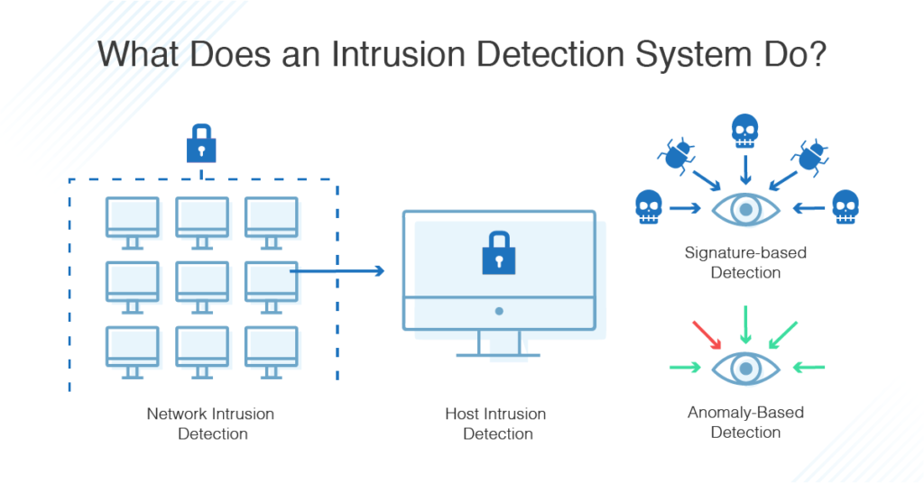

Slide 11
Email Security
Email security describes different techniques for keeping sensitive information in email communication and accounts secure against unauthorized access, loss or compromise. Email is often used to spread malware, spam and phishing attacks. Attackers use deceptive messages to entice recipients to part with sensitive information, open attachments or click on hyperlinks that install malware on the victim’s device. Email is also a common entry point for attackers looking to gain a foothold in an enterprise network and obtain valuable company data.
Email encryption involves encrypting, or disguising, the content of email messages to protect potentially sensitive information from being read by anyone other than intended recipients. Email encryption often includes authentication

Slide 12
How Secure Is Email?
Email was designed to be as open and accessible as possible. It allows people in organizations to communicate with each other and with people in other organizations. The problem is that email is not secure. This allows attackers to use email as a way to cause problems in attempt to profit. Whether through spam campaigns, malware and phishing attacks, sophisticated targeted attacks, or business email compromise (BEC), attackers try to take advantage of the lack of security of email to carry out their actions. Since most organizations rely on email to do business, attackers exploit email in an attempt to steal sensitive information.

Slide 13
Administrating Security
Security Plan A security plan is a document that describes how an organization will address its security needs. The plan is subject to periodic review and revision as the organization's security needs change.
security plan identifies and organizes the security activities for a computing system. ▪ The plan is both a description of the current situation and a plan for improvement

Slide 14
Steps in Administrating Security
Security Planning
Risk Analysis
Organizational Security Policy
Physical Security

Slide 15
Security Planning
Every security plan must address seven issues:
policy
Current State
Requirement
Recommended Control
Accountability
TimeTable
Continuing Attenstion

Slide 16
Risk Analysis
Risk analysis is the process of identifying and analyzing potential issues that could negatively impact key business initiatives or critical projects in order to help organizations avoid or mitigate those risks.

Slide 17
Organizational Security Policy
A security policy is a high-level management document to inform all users of the goals of and constraints on using a system.
A policy document is written in broad enough terms that it does not change frequently. The information security policy is the foundation upon which all protection efforts are built. It should be a visible representation of priorities of the entire organization, definitively stating underlying assumptions that drive security activities

